Slide 1

FoodHub
Coded by:
Backend: Levente Tüdős
Frontend: Bence Budai

Slide 2
The purpose of our project?
Create an enviroment for home chefs
1
Users can search freely between recipies
2
Users can share their own recipies
3

Slide 3
Folder structure
ProjectWork (main folder)
Css → css file
Database → everything about our database
Docx → the project work’s documentations
Html → html file (webpages)
Images → image for the the html files
Upload → uploaded images for the uploaded recipes
Js → js files for the backend and the frontend

Slide 4
The tasks for the Backend
Server side connection
Communication between
the server and the database
the server and the website
Creating REST APIs

Slide 5
The tasks for the Frontend
Making the design
01
User friendly
Compatible with the Backend
Responsive so it can be used on all devices (PC, Laptop, Phone, etc.)
Making tests so we can be sure that the website works as intended
02
Using the modern coding styles and softwares, code languages
03

Slide 6



Backend technologies
Server:
NodeJS
JavaScript
Express.js
Database:
MySQL

Slide 7
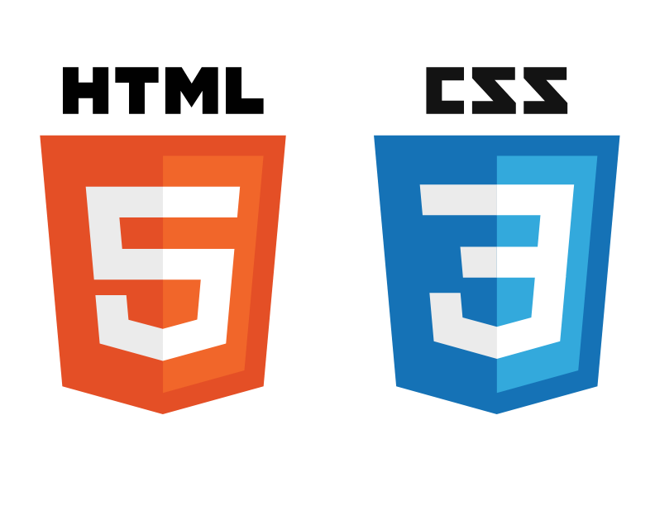



Frontend technologies
Design:
Figma
Coding:
Bootstrap
JavaScript
CSS
HTML
Testing:
Cypress

Slide 8
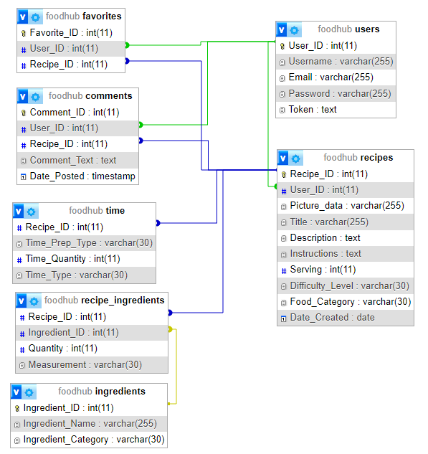
The database structure

Slide 9
Thank you for your attention!

